Slide 1

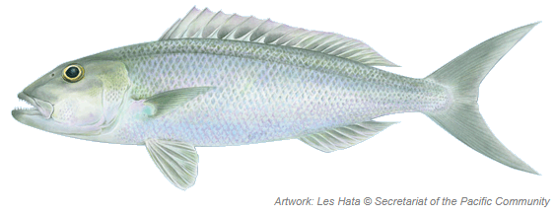
Blue-Green Snapper (uku)

